Slide 1
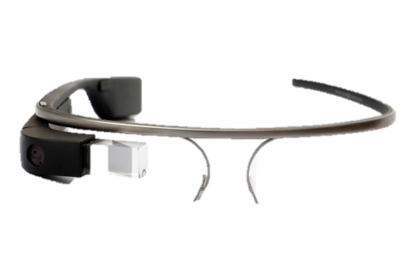
What is Google Glass?

Slide 2
Summary
Introduction to Google Glass
Components and technical features
How does it works ?
The uses
Derived products
Conclusion

Slide 3

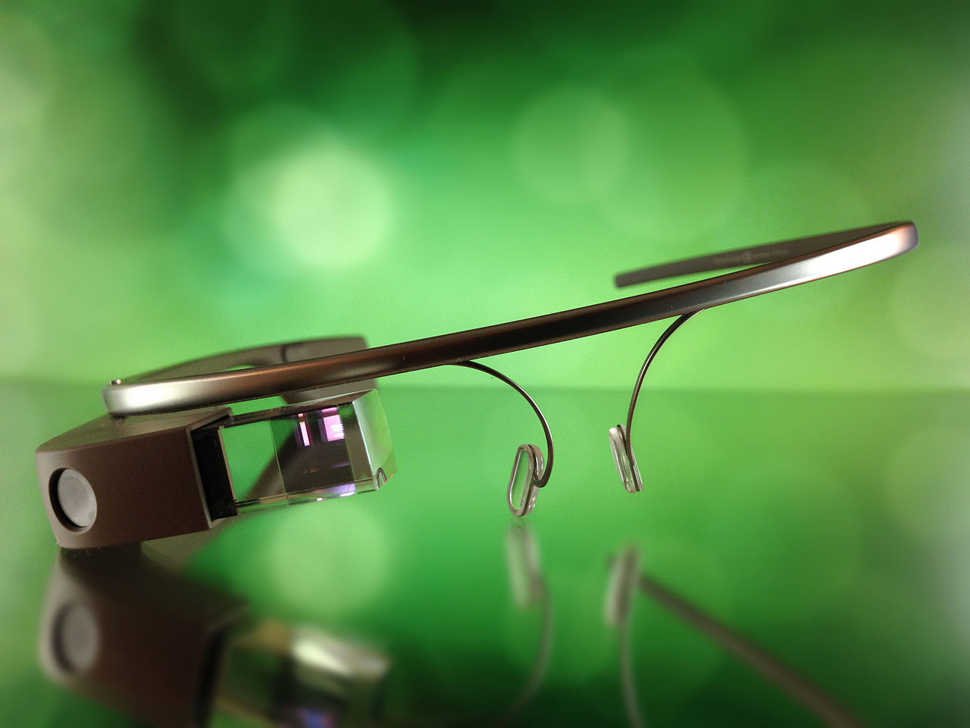
Introduction to Google Glass
- Prototype : april 15, 2013
- Developed by Google X
$1,500
Public may 15 2014
Google Glass Enterprise Edition
announced in july 2017

Slide 4
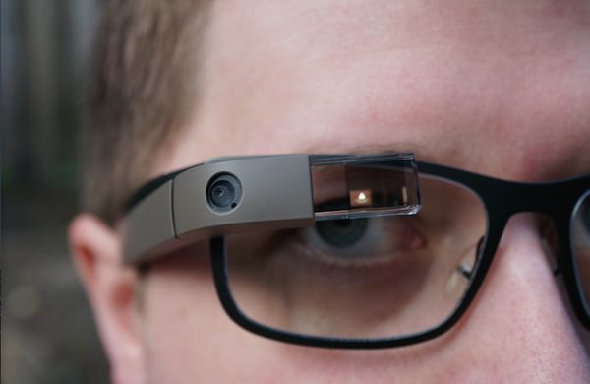
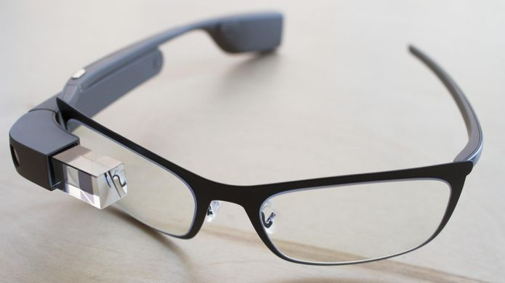
Components and technical features
- Touchpad
Glasses
Prism
2 GB ram
16 GB storage
Glass OS
Wifi,Bluetooth
36g
Camera 5Mp , 720p video
Battery 570 mAh
Micro usb

Slide 5
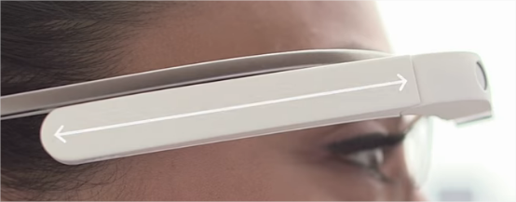
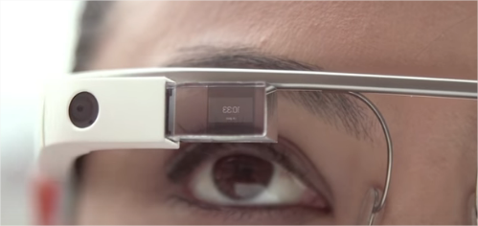
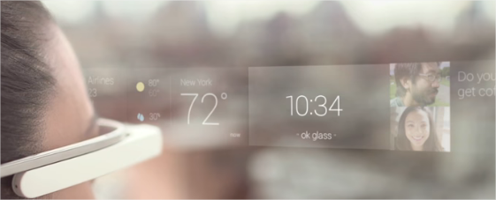
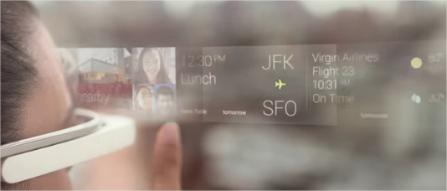
How does it works ?

Slide 6



The uses
Hospital Utilization
Surgeries and Procedures
Help autism people
poachers

Slide 7
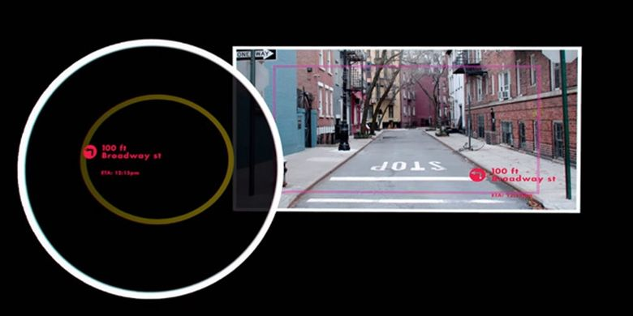
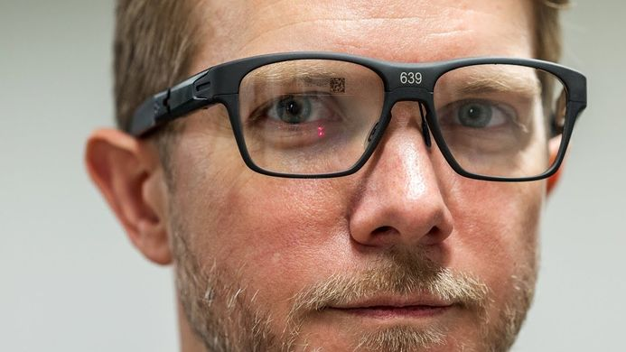
Derived products
IIntel Vaunt

Slide 8
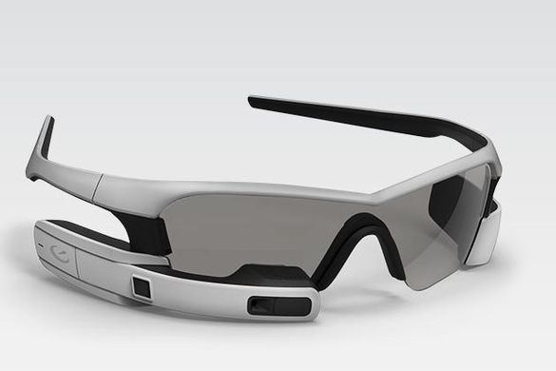

Derived products
Jet recon
Gear Glass (samsumg)

Slide 9
General conclusion

